Slide 1

GOMNATIN JIHAR GOMBE
KASAFIN KUDI
NA SHEKARAR 2026
KASAFI DOMIN HADA KAN NASARORI
KASAFIN KUDI DOMIN AL’UMMA NA SHEKARAR 2026 WANDA MA’IKATAR KASAFIN KUDI DA TSARE-TSARE TA WALLAFA
JANAIRU, 2026

Slide 2
Gabatarwa
A kokarinta da takeyi wajen wayar da kan jamaár Jihar Gombe da sauran masu sha’awar bibiyar kasafin kudin jihar na shekarar 2026, ma’aikatar kasafin kudi da tsare-stare tayi wannar gajeriyar wallafa domin ilmantar da jama’a sha’anin kasafin kudin Gomnatin jihar Gombe daga shekara zuwa shekara, ta hanyar samar da bayani akan kasafin kudin musamman akan hasashen da ake dashi akan nawa ake tsammanin samu, daga wadanne hanyoyi, kuma ta yaya za’ayi amfani da kudaden da aka samu, yana da matukar muhimmanci ga jama’a.
Manufar wannar wallafa shine jama’a da sauran masu ruwa da tsaki zasu samu damar bada tasu gudumawa wajen ganin tsare-tsaren Gomnati sun tafi yadda ya kamata.
Kasafin kudin 2026 anyi masa take da Kasafi Domin Hada kan Nasarori wanda keda zummar cigaba da ayyukan alkhairi da Gomnati mai ci ke gudanarwa

Slide 3
Kasafin Kudi Domin Al’umma: wannar wata wallafa ce da Gomnati ta kanyi a sawwake domin al’umma su fahimci yadda Gomnati take kasafin kudaden ta domin kowa ya fahimci yadda kudaden Gomnati ke amfanar al’umma. Akan wallafa shi ne ta harshen da mutane suka fi fahimta.
Kasafin Kudi: wannan wani tsarin hasashe ne da Gomnati takanyi akan kudaden da take sa ran samu da kuma yadda zata kashe su na tsawon lokaci wanda akan yishi a shekara. Tsari ne wanda Gomnati take yi domin samar da kudaden shiga da kuma ta yadda za’a kashe su akan ayyuka da manufofin Gomnati domin al’umma kudin Shiga: wadannan kudade ne da Gomnati take da kwarin gwiwar zata samu a shekaran kasafin kudi. Ana samun kudin ne daga rabonnin Gomnatin tarayya, harajin cikin gida, tallafi daga ciki da wajen kasa da sauransu.
Kashe Kudi: wannan shine tsarin da Gomnati take yi domin sarrafa kudin da ta samu. Kudin akan kashe su ne a madadin al’umma ta hanyoyi biyu kamar haka: Manyan Ayyuka, Albashi, gudanar da Gomnati tare da biyan basussuka.
Manyan Ayyuka: wannan tsari ne da Gomnati take yi domin kashe kudi akan manyan ayyuka kamar gina tituna, da sauran gineginen gwamanti, samar da lafiya, Ilimi, wajen ayyukan Gomnati, kiyaye muhalli, wutan lantarki, samar da kayan tsaro, da sauransu.
Albashi da Gudanar da Gomnati: wannan tsarin kashe kudi ne da gwamanti take yi akan albashin ma’aikata, da kuma gudanar da gomnati kamar tafiye tafiye, biyan kudin wuta, sayen mai na motoci da injunan wuta da ruwa, sayen kayayyakin gudanar da ofis, kananan gyare gyare da sauransu.
.
MA’ANAR ABUBUWAN DA KASAFIN KUDI YA KUNSA

Slide 4
Bashi: wannan wani tsari ne da gomnati take yi domin ranto kudi daga Bankin Duniya, Bankunan cikin gida, ko kuma masu saka hannun jari domin yin manyan ayyuka, da kudaden shiga baza su iya aiwatarwa ba. Ana biyan kudaden ne ta hanyar biya kai tsaye daga kason jihar wajen rabon wata – wata na tarayya.

Slide 5
Ta ina za'a samar da kudin?

Slide 6
Ta’ina Za’a Kashe Kudaden

Slide 7
Tallafi da ake Tsammani daga Hukumomin da ke Tallafawa domin ci gaba
Daga Ina Za’a Ciwo Bashin?

Slide 8
Babban Manufar Gomnatin Jihar Gombe a Kasafin Kudin 2026
Kasafin Shekarar 2026 yafi maida hankali ne wajen tabbatar da samar da abubuwa kamar haka:
Samar da ci gaban tattalin arziki mai dorewa,
Fadada hanyoyin bunkasa tattalin arziki, da
Inganta hanyoyin samar da aiki mai nagarta.
Haka kuma wadannan muhimman abubuwa da aka lissafa zasu taimaka wajen habaka hukumomi mafiya muhimmanci kamar Hukumomin Ilimi, Kiwon lafiya, Noma, Samar da Tsaftataccen ruwan sha da kuma ci gaba da samar da ababen more rayuwa wanda za su yi daidai da tsarin Kundin ci gaba na Jiha (DEVAGOM) da kuma cimma muradun karni (SDGs).

Slide 13
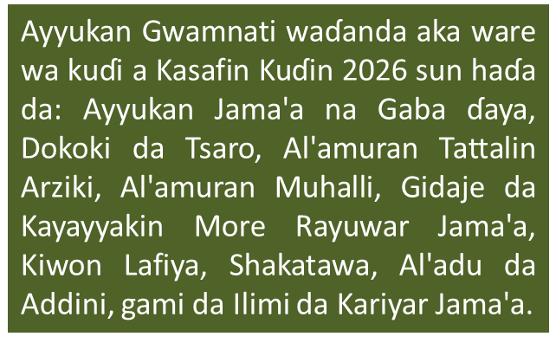
Jimillar Kuɗaɗen da za’a Kashe Gwargwadon Rarrabuwan Aikin Gomnati

Slide 14
Jimillar Kashe-kashen Kuɗi gwargwadon Shirye-shirye (Sashe, Maƙasudi, da Shirye-shirye)

Slide 15
Kudaden da Za’a Kashe ta fuskar Rarrabuwar Tattalin Arziki

Slide 16
Kuɗaɗen da Za’a Kashe kan Kiwon Lafiya a Matakin Farko Bisa Rabe-Raben Gudanar da Gomnati
Kuɗaɗen da Za’a Kashe kan Kiwon Lafiya a Matakin Farko Gwargwadon Rarrabuwan Aikin Gomnati
Kuɗaɗen da Za’a Kashe kan Kiwon Lafiya a Matakin Farko bisa Rarrbuwar Shirye-Shiryen Gomnati

Slide 17
Kuɗaɗen da aka Kashe kan Kiwon Lafiya na Matakin Farko ta fuskar Rarrabuwar Tattalin Arziki

Slide 19
Kudaden da Za’a Kashe wajen Kula da Ilimi Matakin Farko Bisa Rabe-Raben Gudanar da Gomnati
Kudaden da Za’a Kashe wajen Kula da Ilimi a Matakin Farko Gwargwadon Rarrabuwan Aikin Gomnati
Kudaden da Za’a Kashe wajen Kula da Ilimi a Matakin Farko bisa Rarrbuwar Shirye-Shiryen Gomnati

Slide 20
Kuɗaɗen da aka Kashe kan Kula da Ilimi a Matakin Farko ta fuskar Rarrabuwar Tattalin Arziki

Slide 29
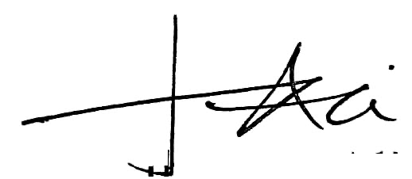
Domin Neman Karin Bayani, Tuntubi:
Salihu Baba Alkali
Komishina, Ma’aikatar Kasafin Kudi Da Tsare Tsare
08065175711
sbalkali@yahoo.co.uk
Muhammad Gambo Magaji
Komishina, Ma’aikatar Kudi
08033139948
mgm262@yahoo.com
Jalo Ibrahim Ali, mni
Sakataren Dindindin Na Ma’aikatar Kasafin Kudi Da Tsare Tsare
08034140577
Jaloali45@gmail.com
Kabiru Tsoho
Darakta Janar a Hukumar kula da Basussuka ta Jiha
08035885655
Kabirutsoho38@gmail.com

Slide 30

GOMNATN JIHAR GOMBE
KASAFIN KUDI
DOMIN AL’UMMA
NA SHEKARAR 2026
KASAFI DOMIN HADA KAN NASARORI

